Slide 1


Call Center Training Tips
A - Attitude
Always have a positive Attitude
There is Difference Between Benefit and Features. Feature is a distinctive or noticeable quality or something offered on a special attraction. Benefit is something that is helpful or advantage or increase one’s well being, always highlight benefits and features promptly
B - Benefits

Slide 2

Call Center Training Tips
C - Closing Question/Statement
Is there anything else, I can do for you?
It will be my pleasure to serve you.
We are here to serve you as you want.
To best thing is to do is to call
The pleasure’s are mine.

Slide 3

Call Center Training Tips
D - Details
Ask complete detail from the caller i.e. day, time, phone number
Don’t assume anything try to judge the need of customer.
Don’t put the customer on hold before asking the customer.

Slide 4

Call Center Training Tips
E - Echo Question
Ask question for more information.
Sir, would you like to give me your First name, Last name, email address.
Entire customer information details in one form carefully.

Slide 5

Call Center Training Tips
F - Finish for the day
Get Ready for the next day.
Start your day with enthusiasm, energetically, actively and positively.
Forget all negativities, be Optimistic instead of pessimistic.

Slide 6

Call Center Training Tips
G - Greeting
Always use the right greetings i.e. “How are you doing today”
Good Morning Sir, I am XYZ from Capitaworld Pvt. Ltd., how may I help you?
Customer should feel that you really care.

Slide 7

Call Center Training Tips
H - Humor
When the caller is joking, go on, treat him/her as he/she wants to be treated.
By honing your skills try to raise interest of customer which will help you to make it good conversation.
Always give maximum honor to the customer.

Slide 8

Call Center Training Tips
I - Irritate
Never ever try to ask irritating questions to the customer.
Improvise the script according to the nature of call.

Slide 9

Call Center Training Tips
J - Justify
Customer is always Justify i.e. if customer has any kind of complain try to give him satisfactory answer instead of lame excuses.
All Complains, bring the problem in the notice of higher management and appreciate customer i.e. thank you for your complain, that you put in my attention on it.

Slide 10

Call Center Training Tips
K - Know your Object
Always plan what you want to achieve from every single call.
Always remember every call is query/ problem call but it’s all depend on your knowledge and skills.
Keep your all attention on your job, whether it be wander.

Slide 11

Call Center Training Tips
L - Let’s
Use encouraging, affirmative expression and listen rather than to reply.
Make yourself positive and face the problem with the attitude of let’s solve it.

Slide 12

Call Center Training Tips
M - Monogram the call
Ask the caller name and use it properly.
Voice must be monogram accordingly the nature of call.
Must be aware how much word should be speak in a minute and should not speak too fast.

Slide 13

Call Center Training Tips
N - Naturally Inquisitive
Do not be Nosy.
Do not show ill feeling while listing to the call, although customer is not watching you, but your voice is showing lack of interest in job or service.
Never hang up the call before the customer.

Slide 14

Call Center Training Tips
O - One word Answer
Do not use one word answer.
Customer will be frustrated due to your negative or low moral support.
Always remember one frustrated customer affect at least one to eight persons.

Slide 15

Call Center Training Tips
P - Practice being Positive
Always give Positive answers.
Remember. you can't choose what happens, but you can choose your positive attitude.
Be cool, calm, positive and try to understand why ill feeling are burning inside you.

Slide 16

Call Center Training Tips
Q - Quality
Maintain the quality of conversation on call.
Use Respectful word while talking to customer.
Don’t use improper language or tone.
Only use formal language while on call.

Slide 17

Call Center Training Tips
R - Rejection
Customer never rejecting us so dont't take it personally.
If some customer is harsh or rude with you, then don't be panic or impatient because he has problem with company not with you. He don't even know your original name.

Slide 18

Call Center Training Tips
S - Smile
Always smile, it warms up the conversation.
If you talk with customer in smiling tone you can change burning customer into loyal, and can talk politely
Remember, that a complaint is a problem and need solving session, it's not battle of right or wrong, customer need only yours positive response/positive solution.

Slide 19

Call Center Training Tips
T - Tone of Voice
Always speak with friendly tone.
Empathy and sympathy in voice.
Try to understand the need/wants or requirement of the customer.
Let the customer talk freely or air him out and listen him in soft tone, provide him permissive environment.

Slide 20

Call Center Training Tips
U - Understanding Needs
Understand the need of the customer. Don't assume anything by your own.
If you don't understand what customer is asking for the ask him/her again and clarify what he/she wants.
Don't provide unnecessary or wrong information on your own assumption.

Slide 21

Call Center Training Tips
V - Vary your Response
Use Different phrases and bring variation to your response.
That's a good Question.
i will be happy to do that for you.
Is there any else I can do for you.
The pleasure's all mine.
That's not a problem at all.

Slide 22
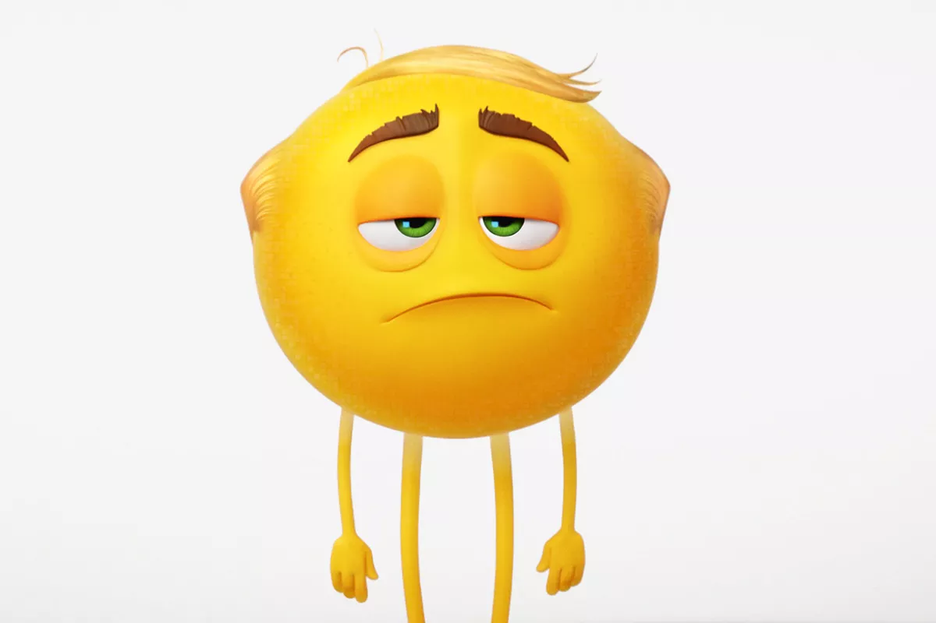
Call Center Training Tips
W - Weak/wimpy Words
Don't use words like, I think, just etc.
Never say to customer , I can't help you this time.
Don't say call me later I am busy.
Don't show off yours and others weakness in front of customer, it build bad impact of company.

Slide 23

Call Center Training Tips
X - Ax out credibility Busters.
Don't say, to be honest, to tell truth.
Use Professional words i.e. may I know your name, number, email address?
Don't cut the customer in between. Let him/her speak till the end and listen want they want from us.

Slide 24

Call Center Training Tips
Y - Yes You Can
Prepare yourself with the attitude of solving each and every issue.
Tell yourself that you can do it. You can provide necessary solution to every customer.

Slide 25

Call Center Training Tips
Z - Zoom the End
It is very important aspect how to close the call.
Use valuable words.
Sir, If you are busy may I call you later, What's yours favorable time?
Have a good day.
Nice talking to you.
Thanks for your precious time.

Slide 26


